Slide 1
Development of master curricula for natural disasters risk management in Western Balkan countries
NatRisk project
Milan Gocić
University of Nis
Sarajevo, 04 September 2019
Project number: 573806-EPP-1-2016-1-RS-EPPKA2-CBHE-JP
"This project has been funded with support from the European Commission. This publication reflects the views only of the author, and the Commission cannot be held responsible for any use which may be made of the information contained therein"

Slide 2
Basic Information
Development of master curricula for natural disasters risk management in Western Balkan countries
Contract number 573806-EPP-1-2016-1-RS-EPPKA2-CBHE-JP
Project acronym NatRisk
Project name Development of master curricula for natural disasters risk management in Western Balkan countries
Project duration 15th October 2016 - 14th October 2019
Programme ERASMUS+ – Call for Proposals EAC/A04/2015
Total cost 1,245,746.00 €
Coordinator University of Niš, Serbia
Univerzitetski trg 2, 18000 Niš, Serbia
Project website www.natrisk.ni.ac.rs
Project e-mail natriskuni@gmail.com

Slide 3
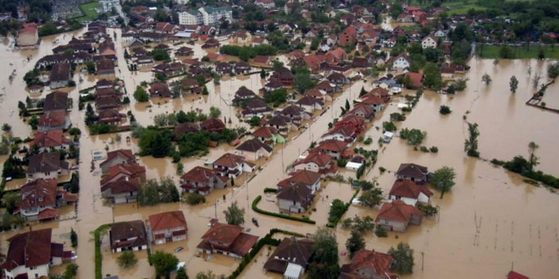
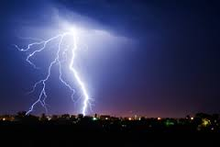
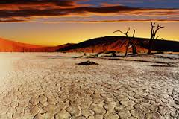
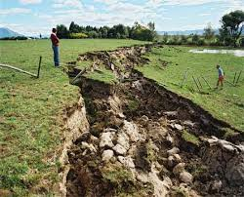
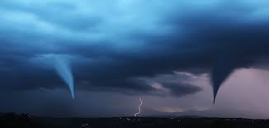
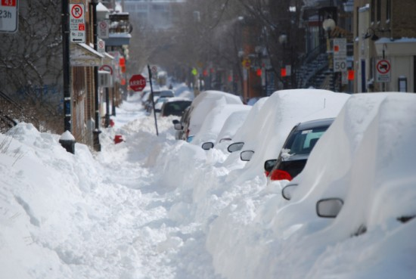
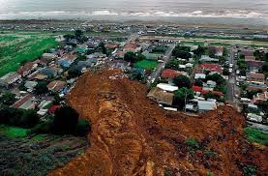
Natural hazards
Development of master curricula for natural disasters risk management in Western Balkan countries
flood
volcanic eruption
thunderstorm
drought
earthquake
tornado
high wind speed
heavy snowfall
landslide

Slide 4
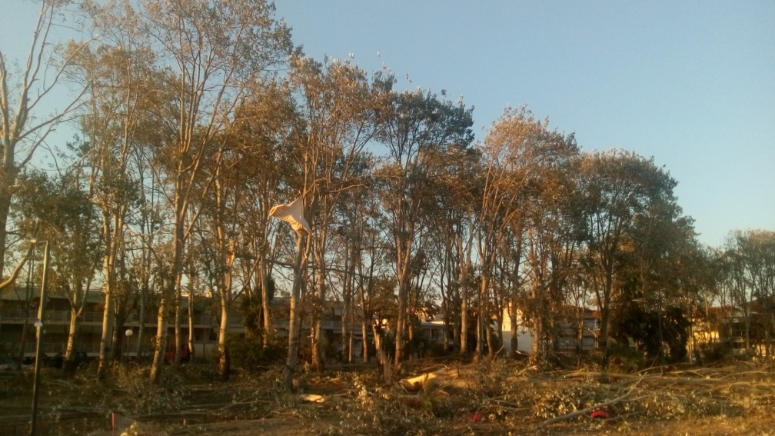
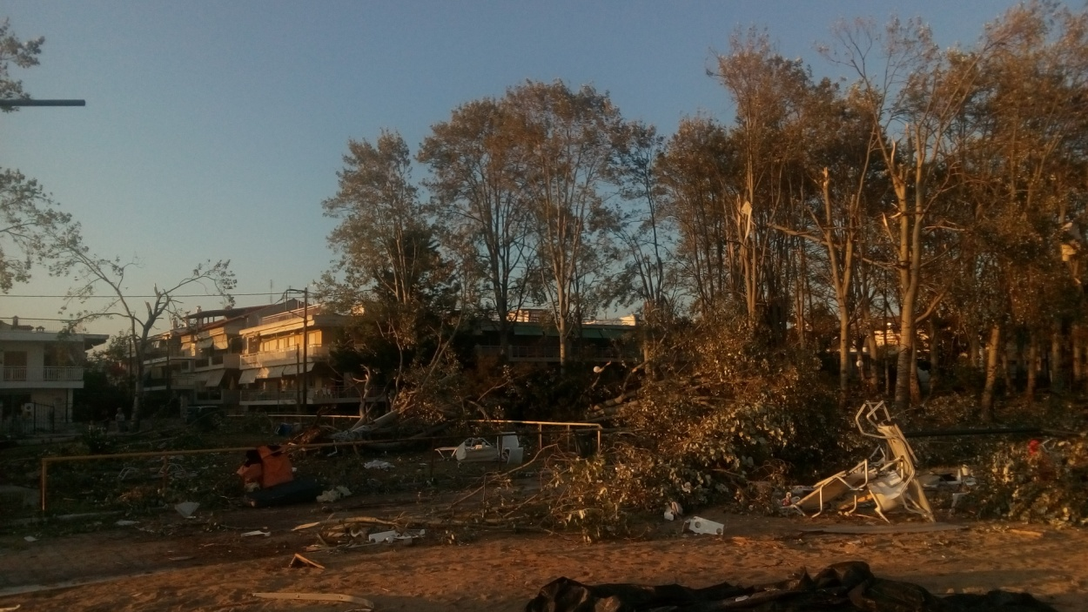
Chalkidiki, Greece, July 2019
Development of master curricula for natural disasters risk management in Western Balkan countries

Slide 5
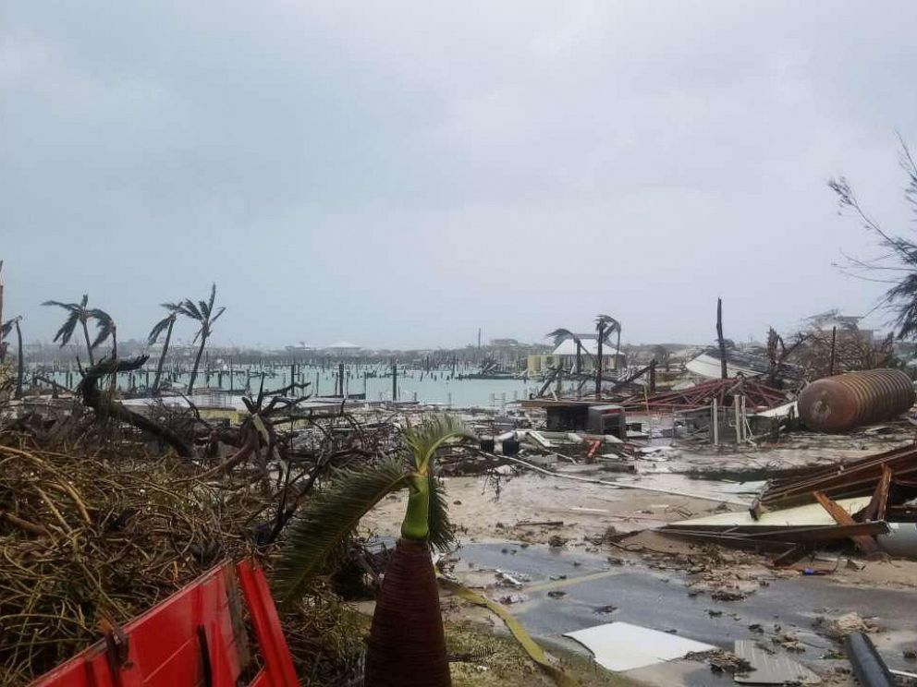
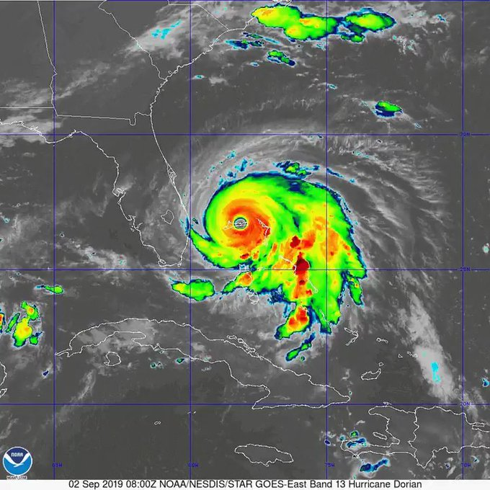
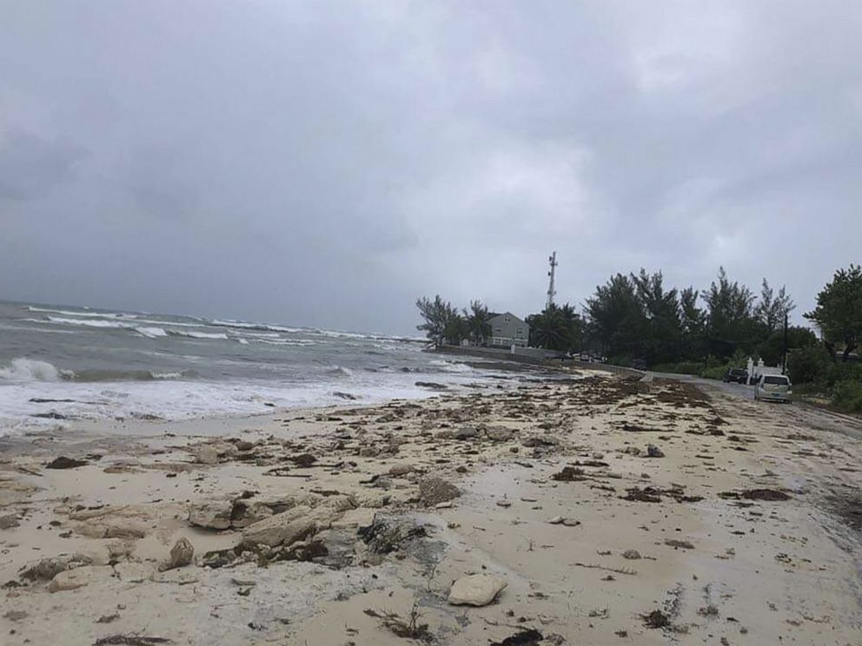
Bahamas, September 2019, hurricane Dorian
Development of master curricula for natural disasters risk management in Western Balkan countries

Slide 6
Natural hazards
Development of master curricula for natural disasters risk management in Western Balkan countries
Natural hazards cause directly significant loss of life, set back economic and social development, reductions in crop yields, destruction of homes and other infrastructure and indirectly increased food prices and food insecurity.
We cannot avoid natural hazards, but we can prevent them from becoming disasters.
More than 1.5 billion people have been affected by disasters in various ways and the total economic loss was more than $1.3 trillion (Sendai Framework for Disaster Risk Reduction 2015-2030). Between 2002 and 2014 natural disasters in the EU caused over 80000 deaths and over €100 billion of economic losses.

Slide 7
Motivation
Development of master curricula for natural disasters risk management in Western Balkan countries
Natural disasters risk management became the greatest global challenge and an indispensable requirement for sustainable development and is set as a goal both in Europe 2020 (target 3. climate change) and the 2030 agenda for Sustainable Development United Nations (“Goal 13. Take urgent action to combat climate change and its impacts“).
WB countries should above all develop new or improve the existing education in this field, to raise technical capacity and accomplish creation of more efficient systems for better response when natural disasters occur.

Slide 8
Overall Broader Objective
Development of master curricula for natural disasters risk management in Western Balkan countries
Education of experts for prevention natural disasters in the region of Western Balkan (WB) according to the national and EU policies.

Slide 9
Specific Objectives
Development of master curricula for natural disasters risk management in Western Balkan countries
Development and implementation of methodology for identification of natural disasters to be managed in WB region and all aspects of prevention and consequences in order to define specific competencies for professional practice
Development and implementation of the new advanced master curricula in Natural Disasters Risk Management (NDRM) in line with the Bologna requirements and national accreditation standards
Development of trainings for the public sector and citizens for reaction in case of various natural disasters

Slide 10
Consortium
Development of master curricula for natural disasters risk management in Western Balkan countries
EU partners
 | University of Natural Resources and Life Sciences, Vienna (BOKU, Austria)
 | Middlesex University Higher Education Corporation (MUHEC, UK)
 | University of Messina (UNIME, Italy)
 | Óbuda University (OE, Hungary)
 | Technical University of Crete, Chania (TUC, Greece)

Slide 11
Consortium
Development of master curricula for natural disasters risk management in Western Balkan countries
WB partners
 | University of Niš (UNI, Serbia)
 | University of Criminal Investigation and Police Studies (KPU, Serbia)
 | University of Pristina in Kosovska Mitrovica (UPKM, Kosovo*)
 | University of Sarajevo (UNSA, Bosnia and Herzegovina)
 | University of Banja Luka (UBL, Bosnia and Herzegovina)
 | Technical College of Applied Sciences Urosevac with temporary seat in Leposavic (TCASU, Kosovo*)
 | University of Defence in Belgrade (UNID, Serbia)

Slide 12
Consortium
Development of master curricula for natural disasters risk management in Western Balkan countries
Associated partner
Republic Hydrometeorological Service of Serbia

Slide 13
Work Packages
Development of master curricula for natural disasters risk management in Western Balkan countries
WP1 Analysis of natural disasters needed to be managed in Western Balkan region
Leader: University of Natural Resources and Life Sciences, Vienna
WP2 Development of master curricula
Leader: University of Messina
WP3 Development of trainings for citizens and public sector
Leader: University of Defence in Belgrade
WP4 Implementation of developed master curricula and trainings
Leader: University of Sarajevo

Slide 14
Work Packages
Development of master curricula for natural disasters risk management in Western Balkan countries
WP5 Quality assurance and monitoring
Leader: Middlesex University Higher Education Corporation
WP6 Dissemination
Leader: University of Niš
WP7 Exploitation
Leader: University of Niš
WP8 Project management
Leader: University of Niš

Slide 15
Capacity building
Development of master curricula for natural disasters risk management in Western Balkan countries
A total of 5 training sessions were organized by the EU project partners.
87 WB teaching staff trained for innovative methods in conduction of teaching and advancing the learning process.
Three offices of international relations were established.
A total of 7 labs were equipped with necessary equipment and literature.
6 master programs developed, along with one higher education degree, modernization of one master degree program.
14 training sessions were organized for more than 500 students and public officers out of 150 different institutions.
A total of 115 mobility visits organized for 1200 days, along with 25 student mobility visits for more than 120 months.

Slide 16
Sustainability
Development of master curricula for natural disasters risk management in Western Balkan countries
5 master programs accredited and 4 have already enrolled 72 students for master degree in the 2018/2019 academic year.
A survey was conducted with 3058 persons on disaster risk management and results published.
Four manuals and brochures were delivered to civil sector professionals for natural disasters.
26 inter-institutional agreements signed between Western Balkan higher education institutions and EU partners.

Slide 17
Dissemination
Development of master curricula for natural disasters risk management in Western Balkan countries
More than 80 events (conferences, seminars, workshops, info days), and also on radio and TV presentations.
More than 10 brochures, info leaflets and web online editions.
Web site promotion.
TV and radio interviews, press releases.

Slide 18
Presentations
Development of master curricula for natural disasters risk management in Western Balkan countries
Master curricula in Natural Disasters Risk Management - Giuseppe Titot Aronica
LLL courses for professionals in Natural Disasters Risk Management - Radovan Karkalić
Student internships and traineeships – Jelena Rajović
Special Mobility Strand – Borislava Blagojavić, Slaviša Trajković
Impact of NatRisk on the Western Balkan HEIs – Kurt Glock
BESTSDI & NatRisk synergy and future cooperation – Emina Hadžić

